Slide 1
AI Gun Detection
By: Lauri Soome, Maria Sandu, Adam Young
https://github.com/soomelauri/hackathon-gun-detection

Slide 2
Table of Contents
Problem Statement
Dataset Presentation
Model Presentation
Results
Future Improvements

Slide 3
Problem Statement
Growing concerns around public safety in crowded areas (schools, malls, airports, etc) necessitate the development of smart surveillance systems
Traditional security systems
rely heavily on human monitoring, which is often slow, error-prone, and reactive
lack the intelligence to detect weapons in real time, resulting in delayed response times and increased casualties
Timely detection of firearms and potential shooters can save lives!
An AI security system can be a safer alternative to traditional security systems if developed with caution

Slide 4
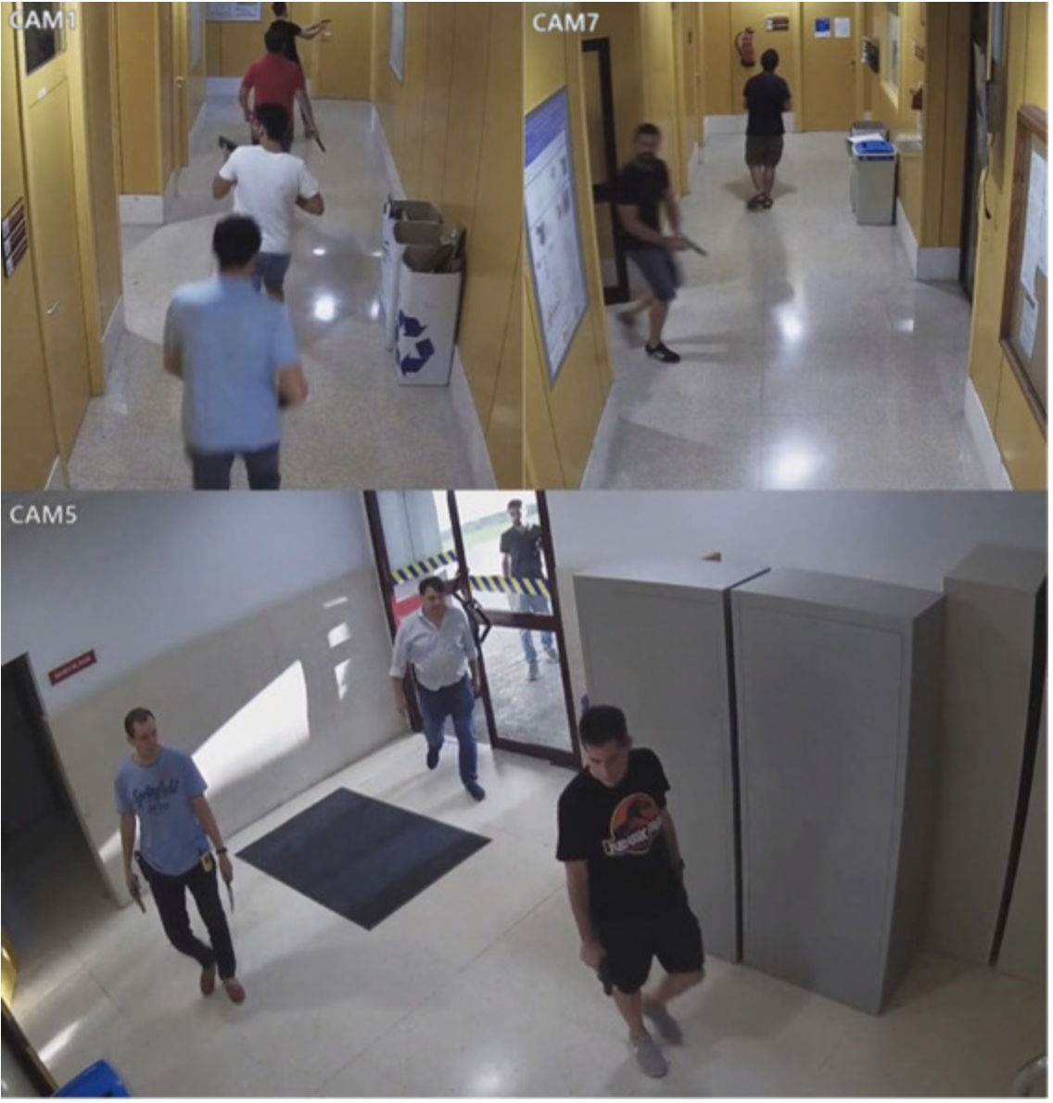
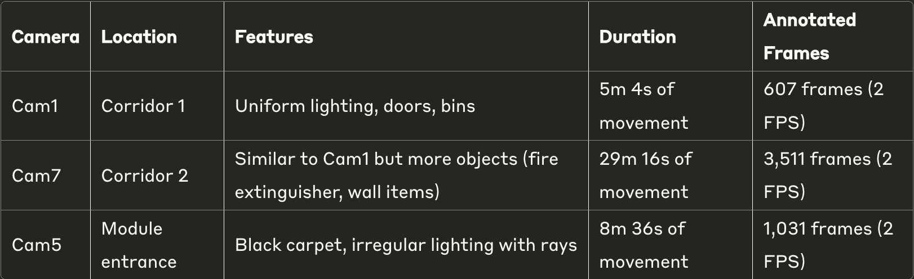
Mock Attack Dataset
Data Collection
Manually annotated dataset from a mock attack at a University
Three surveillance cameras covering two corridors and one entrance
Total Dataset: 5,149 annotated frames across three camera perspectives
Dataset after processing: ~1500 images with a firearm (handgun, short rifle) or a knife, ~1500 images with no weapons. Total dataset => ~3k images
¹Salazar González et al., "Real-time gun detection in CCTV: An open problem," Neural Networks, 2020.

Slide 5
Weapon Detection Model
Model Architecture
YOLO v11n: Smallest variant of the latest YOLO model through Ultralytics
Training Configuration
Dataset: 3-class weapon detection (Handgun, Knife, Short rifle)
Image Size: 320×320 pixels
Training Strategy:
50 epochs with early stopping (patience=10)
Batch size: 64
Optimizer: AdamW
GPU-accelerated training
Total training time: ~1.5h using Colab’s free GPU

Slide 6
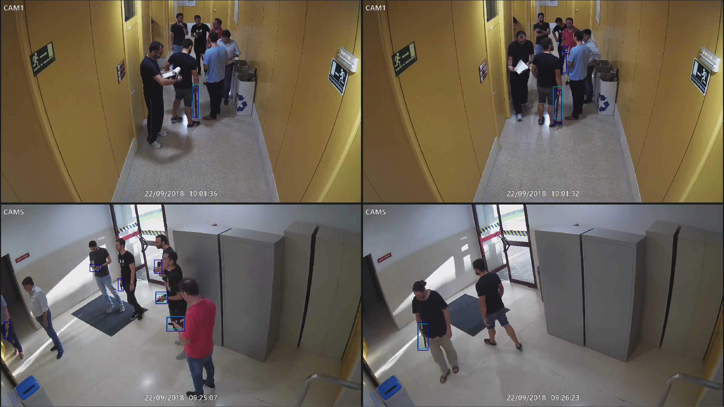
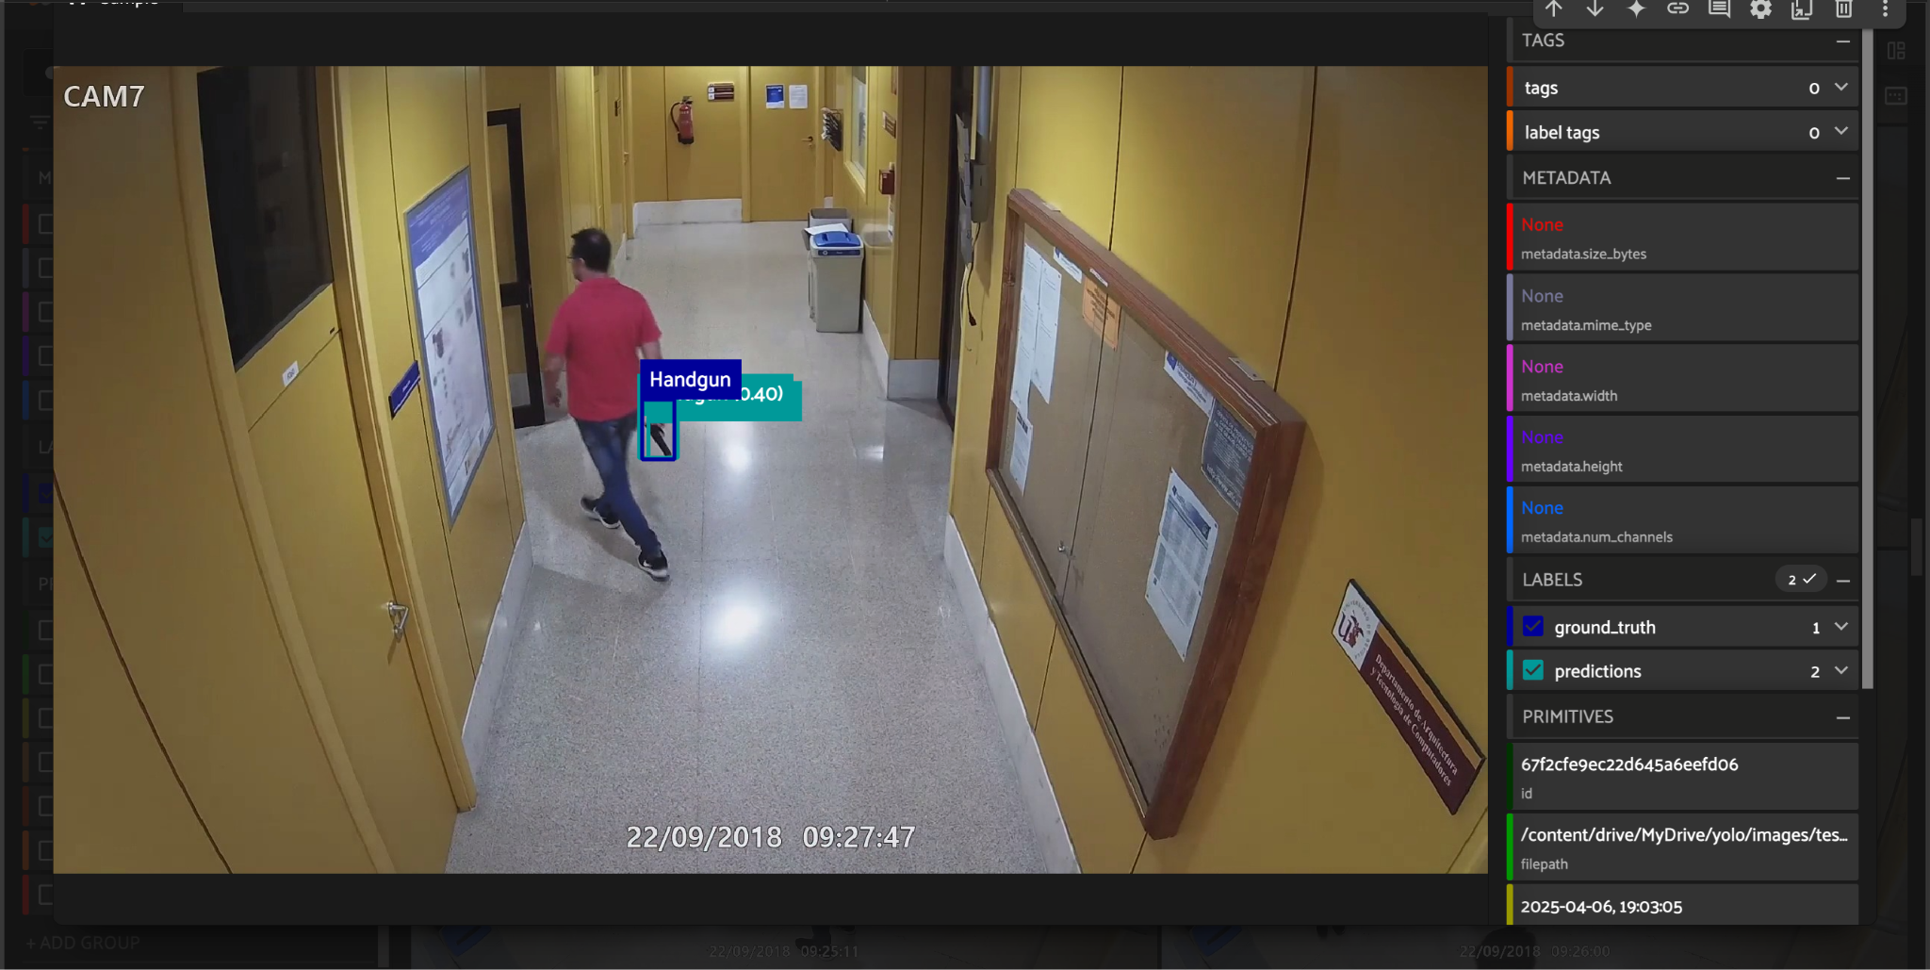
Result Examples Visualized
We used fiftyone to interpret the test results to see which images did the model do well and struggle with.

Slide 7
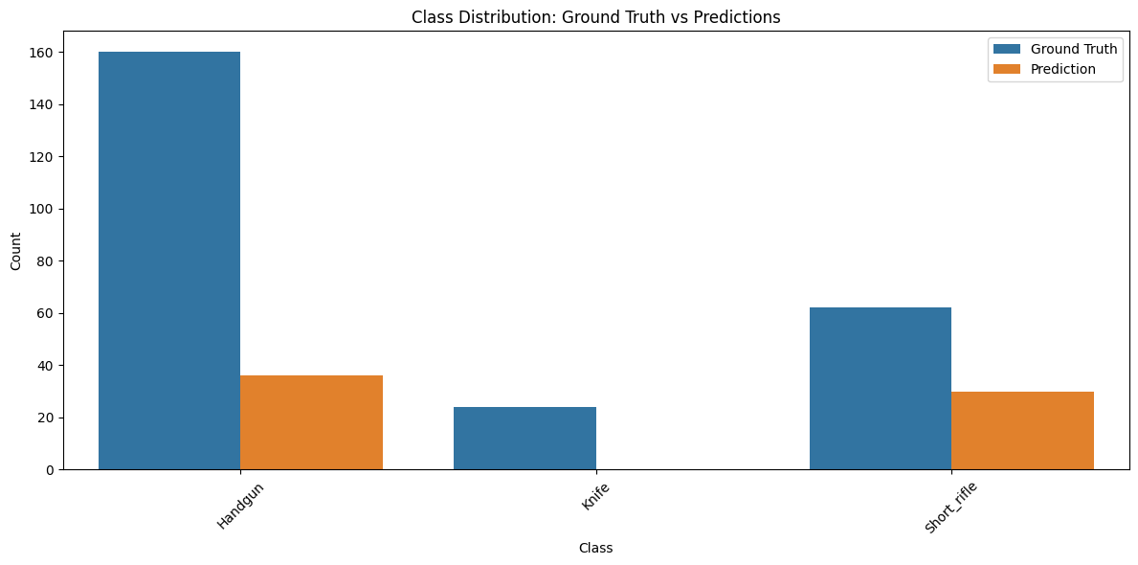
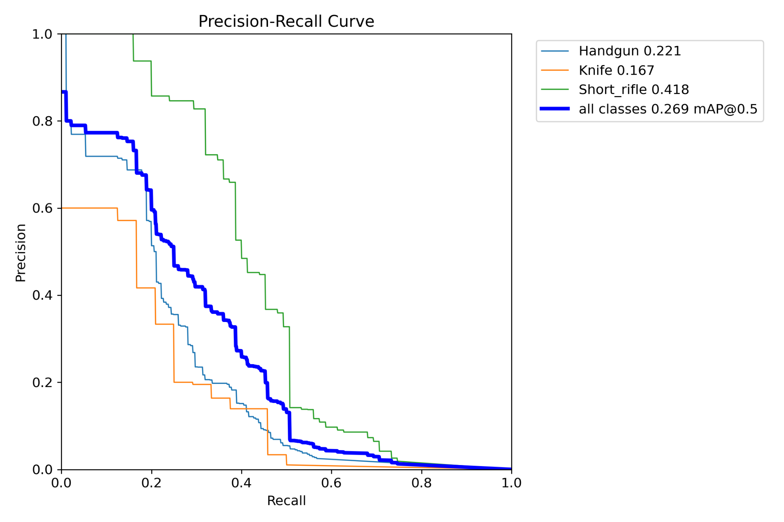
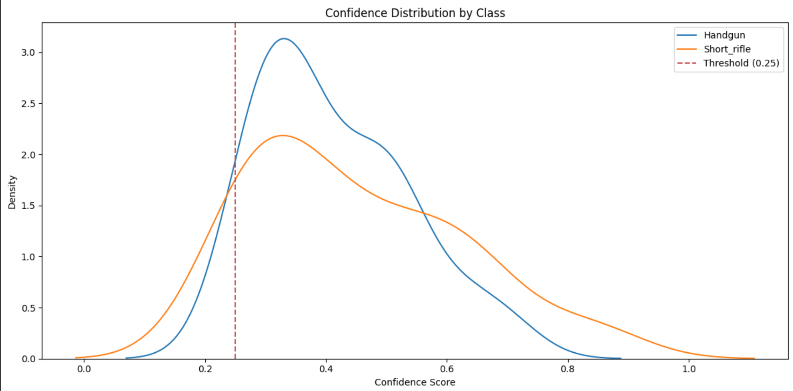
Results

Slide 8
Future Improvements
Larger Models: YOLO 11s, YOLO 11m, YOLO 11m, YOLO 11l, YOLO 11x
Focus on improving real-time detection to reduce response times
Introduce a human-in-the-loop: Gun detected -> Send to human review
Further refinement to minimize false positives and false negatives

